Slide 1


BANGLADESH ARMY UNIVERSITY OF SCIENCE AND TECHNOLOGY
Title: Simple Notepad With Daily Schedule
CSE 2206:Database management systems sessional
Group no: 27
PRESENTED BY:
Shah Md. Eheteshamuzzaman Sabihu
ID:0802320205101099 Nafis Fuad Araf
ID:0802320205101105
PRESENTED TO:
Ashrafun Zannat
Assistant Professor
Tasmim
Lecturer & Program Coordinator
DEPARTMENT OF COMPUTER SCIENCE AND ENGINEERING
1

Slide 2
project
A web-based tool combining personal note-taking, task assignment, and library management
Users can add/view notes, assign and track tasks with team response options (accept/reject)
Integrated mini library system for managing books and students
Designed for simplicity and local use
2

Slide 3
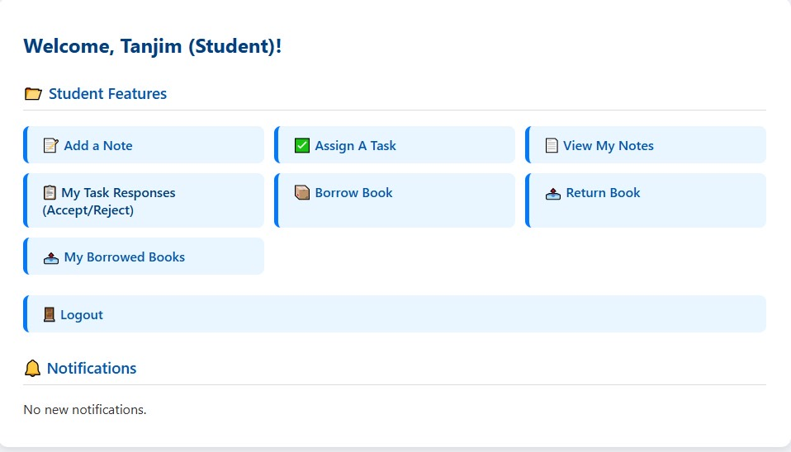
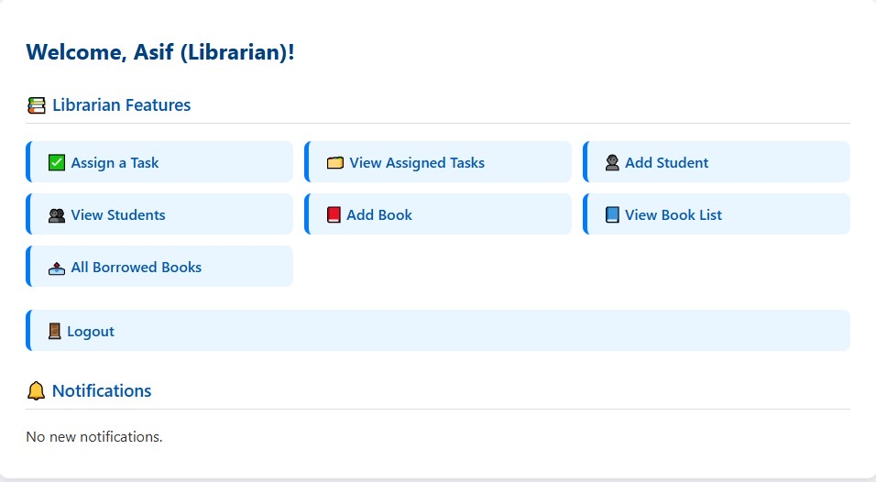
project
3

Slide 4
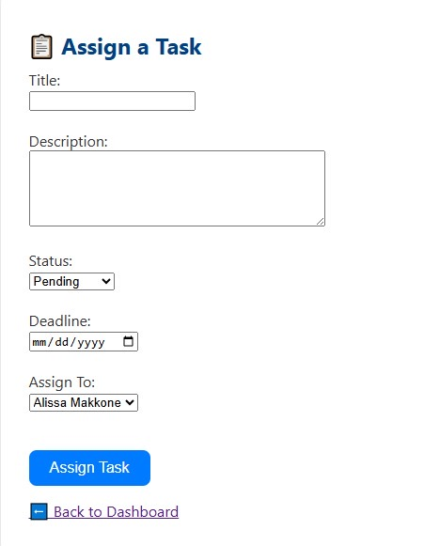
introduction
Combines three key modules: Notepad, Task Management, and Library
Notepad module allows adding and viewing notes
Task module enables assigning tasks, viewing tasks, and tracking team responses (accept/reject)
Library system manages books, students, and borrow/return processes
Built with PHP and MySQL, featuring a clean and user-friendly interface
4

Slide 5
Related works
Comparable to Google Keep and Microsoft To Do (for notes and task management)
Library CMS for book management
Lightweight, custom-built solution tailored for small-scale, local use
5

Slide 6
motivation
People often forget tasks without a clear assignment and tracking system
Paper-based library and task management are inefficient and error-prone
Combining notes, tasks with team collaboration, and library management saves time and effort
Useful for students, teachers, and small teams
6

Slide 7
objectives
Build a system to manage personal notes and assigned tasks with team response tracking
Provide a library management system for books and student records
Ensure data is stored securely in a structured database
Enable smooth workflow with easy interfaces
Project Benefits:
Saves time and effort
Reduces paperwork and confusion
Facilitates team communication on tasks
7

Slide 8
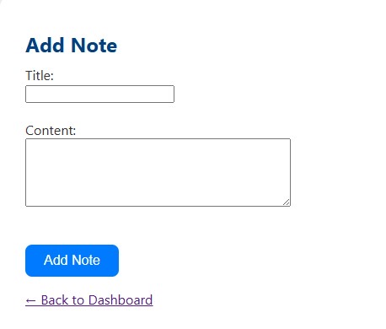
methodology
Users add notes and assign tasks via forms
Team members can accept or reject assigned tasks
Library management supports adding/viewing books and students, borrowing, and returns
PHP handles backend logic and MySQL stores data
CRUD operations implemented for all modules
Simple navigation through buttons and links
8

Slide 9
Tools & technology
Frontend: HTML, CSS
Backend: PHP
Database: MySQL
Others: XAMPP (local server)
9

Slide 10
implementation
Notepad & Task Module:
Add and view personal notes
Assign tasks to team members
View assigned tasks
Team members can accept or reject tasks
Library Module:
Add students and view student list
Add books and view book list
Borrow and return books
View borrowed books list
Logout option for session management
10

Slide 11
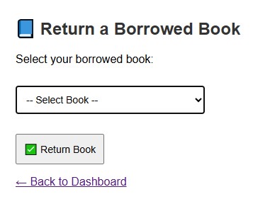
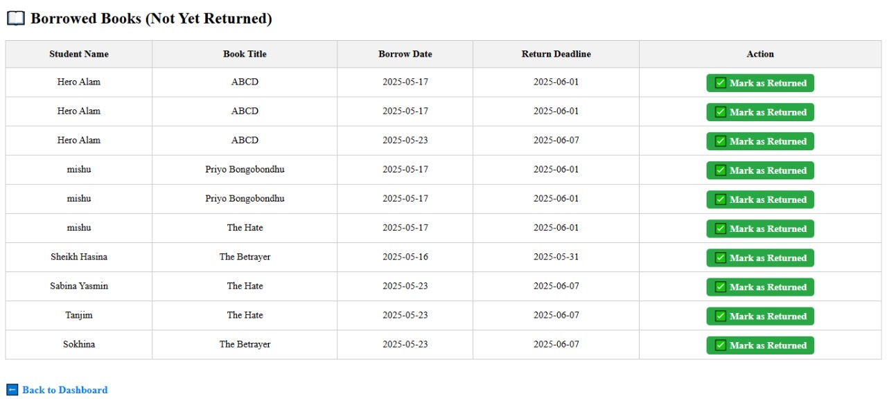
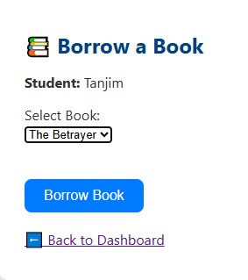
11

Slide 12
limitation
No Cloud synchronization
No overdue or reminder notifications for tasks or books
Data stored only on the local system
12

Slide 13
Future work
Implement user roles and login (admin, students, team members)
Add notification system for overdue tasks and book returns
Enable online multi-user access with synchronization
Add book categories, search filters, and export options (Excel/PDF)
Improve team collaboration features
13

Slide 14
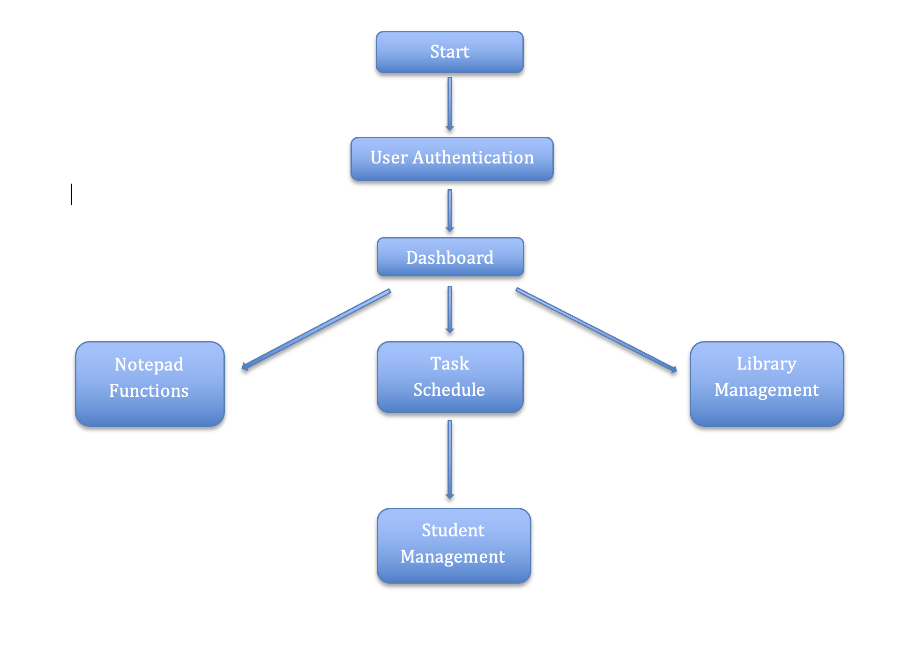
work flow
14

Slide 15
conclusion
Developed a simple yet functional system for notes, task assignment, and library management
Learned integration of multiple modules with PHP and MySQL
Gained experience in user interface design and database management
System can be expanded into a more comprehensive platform
15

Slide 16
references
W3C, “HTML5 Specification,” World Wide Web Consortium (W3C), 2014. [Online]. Available: https://www.w3.org/TR/html5/
M. Keith and M. Andrew, CSS: The Definitive Guide, 4th ed., O’Reilly Media, 2020. [Online]. Available: https://developer.mozilla.org/en-US/docs/Web/CSS
16

Slide 17
Question and answer
Thank you for your attention 🙏
17

Slide 18
Thank you
18

